Slide 1
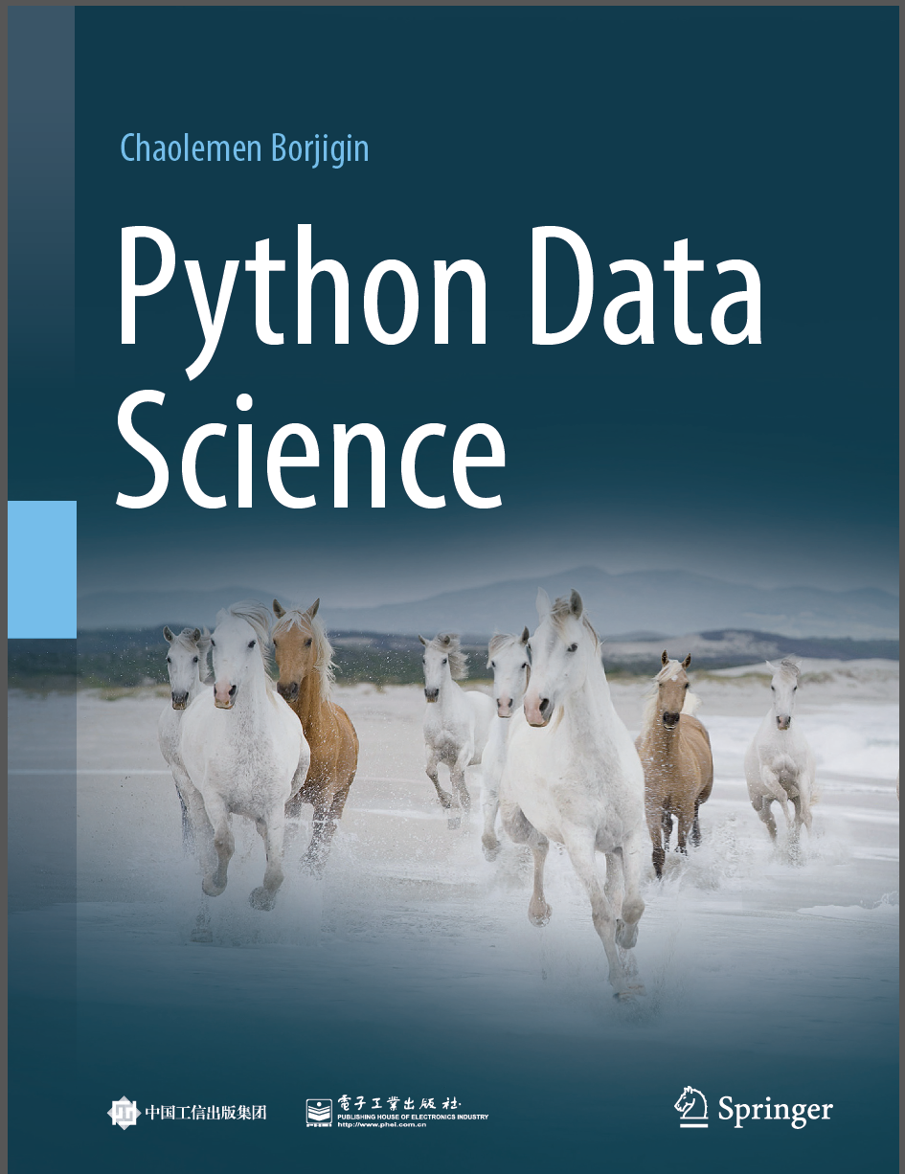
Python Data Science
Chaolemen Borjigin
Renmin University of China
chaolemen@ruc.edu.cn

Slide 2
2.3 Operators and Expressions
▼ Chapter 2 Basic Python Programming for Data Science
► 2.3 Operators and Expressions
Chaolemen Borjigin
Renmin University of China
chaolemen@ruc.edu.cn

Slide 3
Summary of this chapter
▼ Chapter 2 Basic Python Programming for Data Science
► 2.3 Operators and Expressions
2.3.1 Common used operators
2.3.2 Built-in functions
2.3.3 Math modules
2.3.4 Precedence and associativity

Slide 4
2.3.1 Common used operators
▼ Chapter 2 Basic Python Programming for Data Science
► 2.3 Operators and Expressions
In[1]:
x=2
y=5
y/x
Out[1]:
2.5
In[2]:
x=2
y=5
y%x
Out[2]:
1

Slide 5
2.3.1 Common used operators
▼ Chapter 2 Basic Python Programming for Data Science
► 2.3 Operators and Expressions
In[3]:
x=2
y=5
y//x
Out[3]:
2
In[4]:
x=2
y=5
x**y
Out[4]:
4

Slide 6
2.3.1 Common used operators
▼ Chapter 2 Basic Python Programming for Data Science
► 2.3 Operators and Expressions
In[5]:
x=2
y=5
x==y
Out[5]:
False
In[6]:
x=2
y=5
x!=y
Out[6]:
True

Slide 7
2.3.1 Common used operators
▼ Chapter 2 Basic Python Programming for Data Science
► 2.3 Operators and Expressions
In[7]:
x=2
y=5
x is y
Out[7]:
False
In[8]:
x=2
y=5
x is not y
Out[8]:
True

Slide 8
2.3.1 Common used operators
▼ Chapter 2 Basic Python Programming for Data Science
► 2.3 Operators and Expressions
In[9]:
x in [1,2,3,4]
Out[9]:
True
In[10]:
y in [1,2,3,4]
Out[10]:
False
In[11]:
x not in [1,2,3,4]
Out[11]:
False

Slide 9
2.3.1 Common used operators
▼ Chapter 2 Basic Python Programming for Data Science
► 2.3 Operators and Expressions
In[12]:
x=2
y=5
y//=x
print(x,y)
2 2
In[13]:
x=2
y=5
y//=x+8
print(y)
0

Slide 10
2.3.1 Common used operators
▼ Chapter 2 Basic Python Programming for Data Science
► 2.3 Operators and Expressions
In[14]:
x=True
y=False
x and y
Out[14]:
False
In[15]:
x=True
y=False
x or y
Out[15]:
True

Slide 11
2.3.1 Common used operators
▼ Chapter 2 Basic Python Programming for Data Science
► 2.3 Operators and Expressions
In[16]:
x=True
not x
Out[16]:
False
In[17]:
x=2
y=3
print(x,y)
print(bin(x),bin(y))
2 3
0b10 0b11

Slide 12
2.3.1 Common used operators
▼ Chapter 2 Basic Python Programming for Data Science
► 2.3 Operators and Expressions
In[18]:
x=2
y=3
x&y
Out[18]:
2
In[19]:
x=2
y=3
bin(x&y)
Out[19]:
'0b10'

Slide 13
2.3.1 Common used operators
▼ Chapter 2 Basic Python Programming for Data Science
► 2.3 Operators and Expressions

Slide 14
2.3.1 Common used operators
▼ Chapter 2 Basic Python Programming for Data Science
► 2.3 Operators and Expressions
In[22]:
bin(~x)
Out[22]:
'-0b11'
In[23]:
x=2
y=3
bin(x<<y)
Out[23]:
'0b10000'

Slide 15
2.3.1 Common used operators
▼ Chapter 2 Basic Python Programming for Data Science
► 2.3 Operators and Expressions
In[24]:
x=2
y=3
bin(x>>y)
Out[24]:
'0b0'

Slide 16
2.3.2 Built-in functions
▼ Chapter 2 Basic Python Programming for Data Science
► 2.3 Operators and Expressions
In[25]:
pow(2,10)
Out[25]:
1024
In[26]:
round(2.991)
Out[26]:
3
In[27]:
round(2.991,2)
Out[27]:
2.99

Slide 17
2.3.3 Math modules
▼ Chapter 2 Basic Python Programming for Data Science
► 2.3 Operators and Expressions
In[28]:
import math
math.sin(5/2)
Out[28]:
0.5984721441039564
In[29]:
import math
math.pi
Out[29]:
3.141592653589793

Slide 18
2.3.3 Math modules
▼ Chapter 2 Basic Python Programming for Data Science
► 2.3 Operators and Expressions
In[30]:
import math
math.sqrt(2.0)
Out[30]:
1.4142135623730951

Slide 19
2.3.3 Math modules
▼ Chapter 2 Basic Python Programming for Data Science
► 2.3 Operators and Expressions
In[31]:
import math
math.sqrt(-1)
ValueError Traceback (most recent call last)
<ipython-input-31-4e02a0210c6b> in <module>()
1 import math
----> 2 math.sqrt(-1)
ValueError: math domain error

Slide 20
2.3.3 Math modules
▼ Chapter 2 Basic Python Programming for Data Science
► 2.3 Operators and Expressions
In[32]:
import cmath
cmath.sqrt(-2)
Out[32]:
1.4142135623730951j

Slide 21


